Slide 1
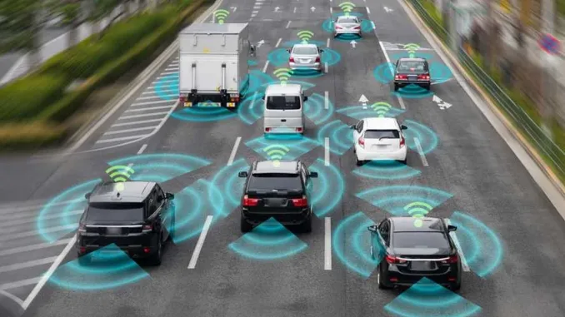
Smart traffic system using Lifi-technology for automobiles
Presented by:
Chandrashekhar Akkenapally
Susheel Reddy Pingili

Slide 2
Problem statement
As the number of vehicles on the road has increased, other difficulties have arisen, such as accidents. These concerns can be addressed by Li-Fi technology for automobiles in smart traffic systems.

Slide 3
Li-fi in smart traffic system
Li-Fi technology can be used in smart traffic systems to improve traffic flow and reduce congestion.
a) Vehicle-to-Vehicle (V2V) communication.
b) Vehicle-to-Infrastructure (V2I) communication.
c) Pedestrian safety.
d) Navigation assistance

Slide 4
Real World Implementation
To commercialize it, each car must have an LED-based traffic headlight, taillight, and Arduino microcontroller Li-Fi technology.
We use this fantastic technology to make the transition to a digital world.

Slide 5
Limitations of Li-Fi Technology
Although Li-Fi technology has several advantages over traditional Wi-Fi, it also has some limitations that must be considered. Some of these limitations include:
a) Line of sight
b) Range
c) Light sensitivity
d) Cost
e) Compatibility

Slide 6
Transmitter Module
The vehicular transmitter module consists of Arduino Uno controller, Gas Sensor for sensing any gas leakage , Alcohol sensor for detecting alcohol consumption by the driver, Ultrasonic sensor for detection of any object intrusion in the road,Setup to detect the fatigue ness of the driver using eye blink control.
It also has the Li-Fi Transmitter module to transfer data from the device to other

Slide 7
Receiver Module
The vehicle receiver module consists of the Arduino controller ,that will be placed at the vehicle 2. This receiver module will have the LDR and LCD Module for displaying the content received from Vehicular Transmitter module.

Slide 8
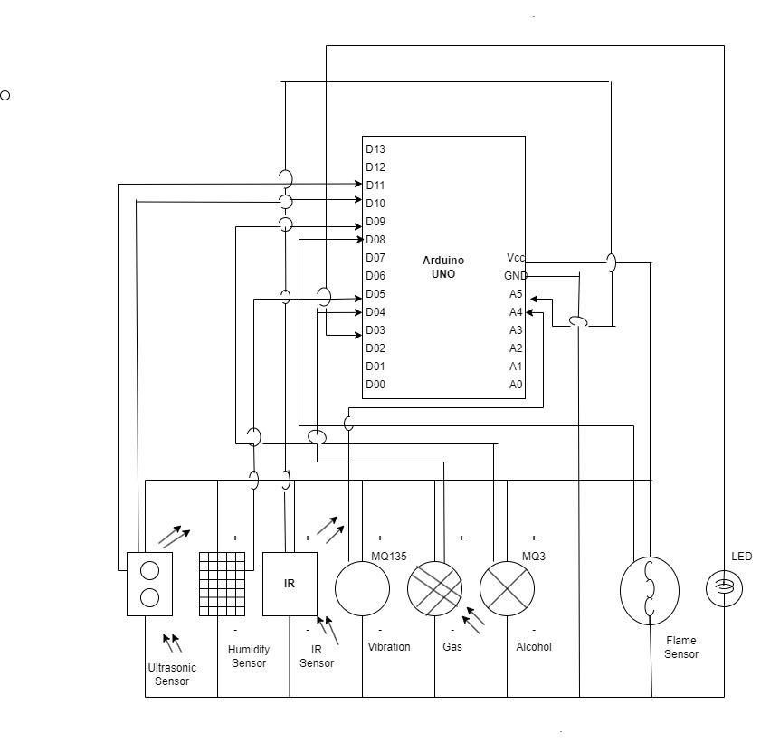
Transmitter circuit Diagram

Slide 9
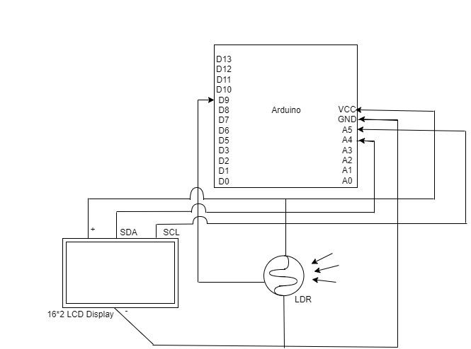
Receiver Circuit Diagram

Slide 10
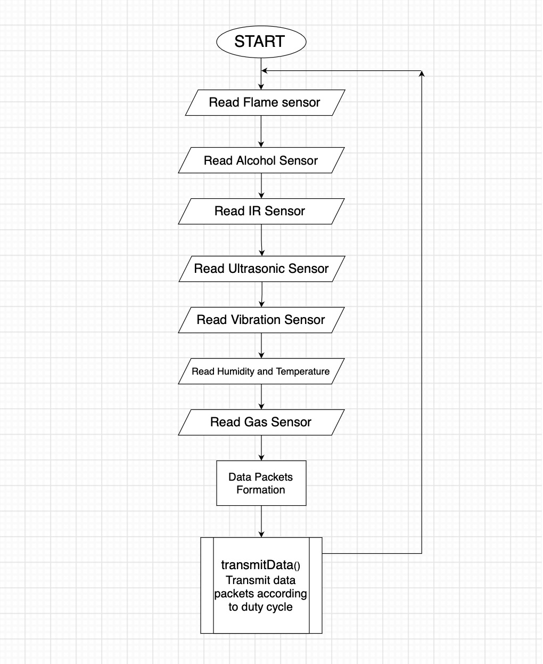
TRANSMITTER FLOW
DIAGRAM

Slide 11
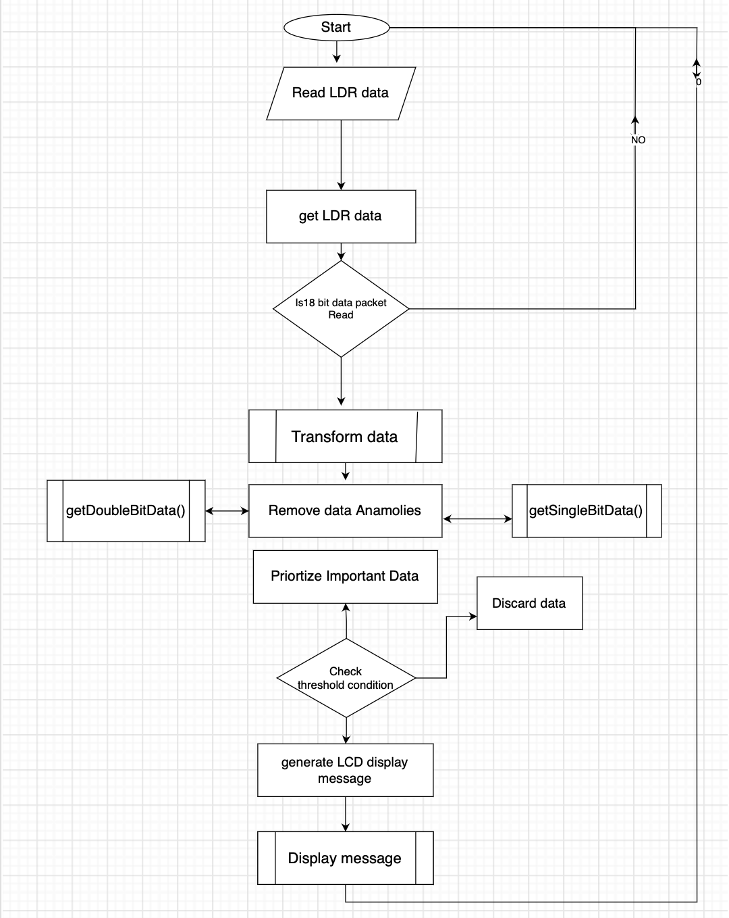
RECEIVER FLOW DIAGRAM

Slide 12
Software
Arduino IDE
The Arduino IDE is a graphical user interface (GUI) for writing and uploading programs to Arduino boards. It includes an editor, compiler, and uploader.
The Arduino IDE also includes a number of capabilities that make debugging your programs simple. A serial monitor, a memory monitor, and a time profiler are among the features.

Slide 13
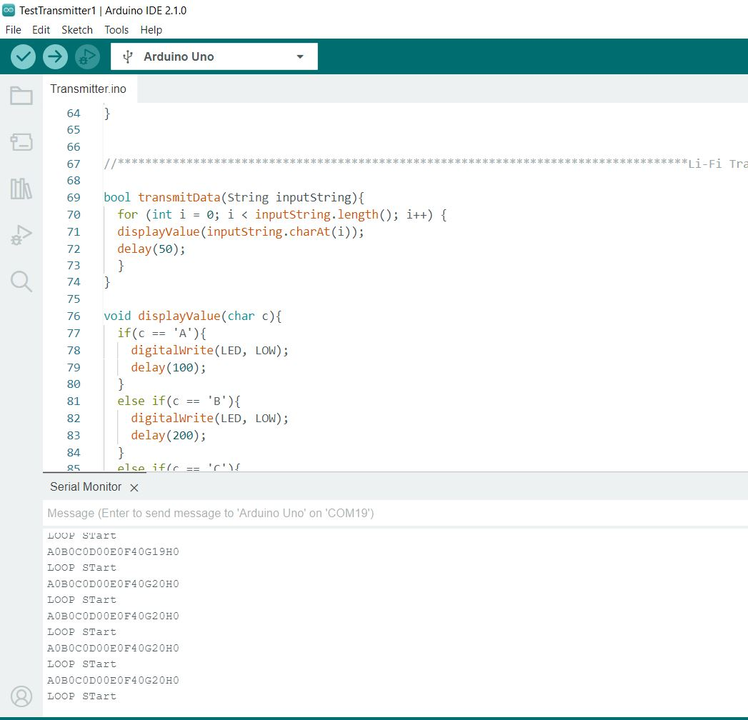
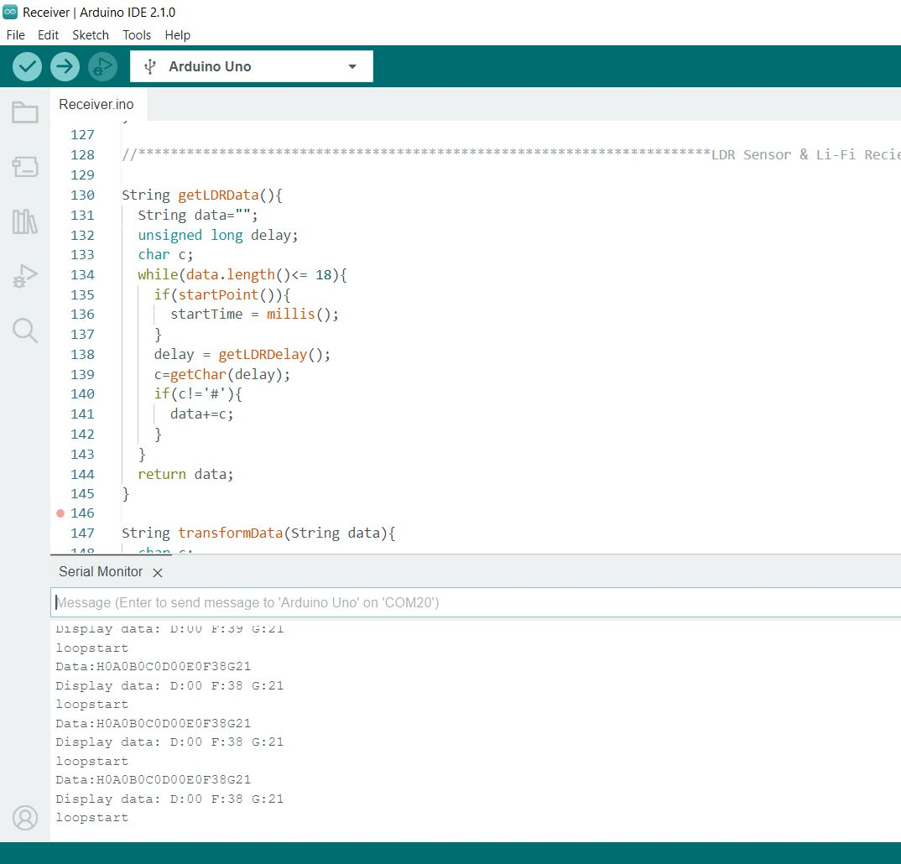
Transmitter & Receiver Code

Slide 14
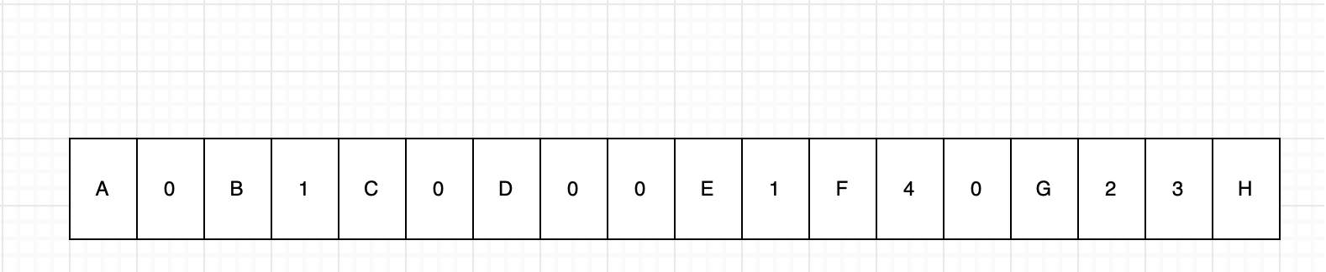
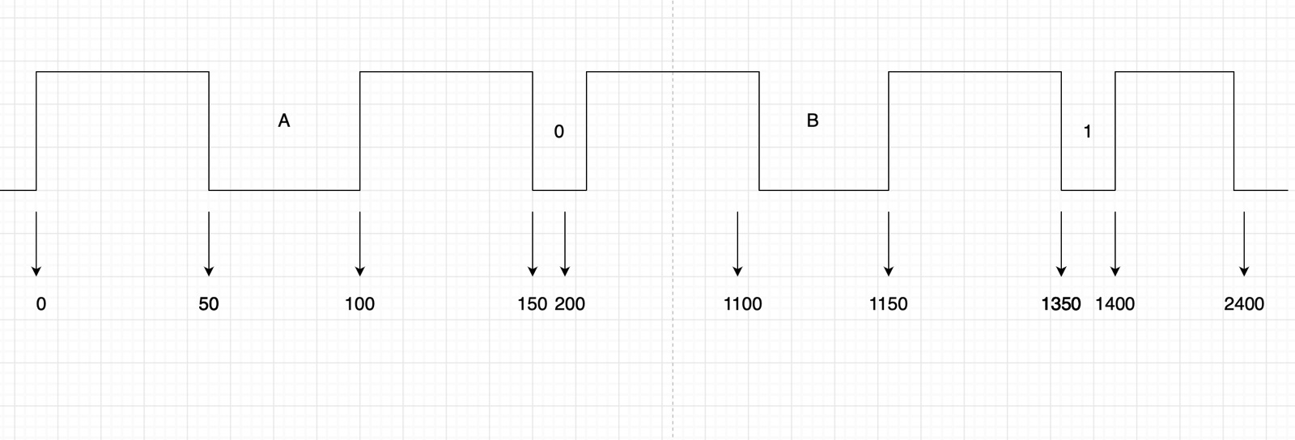
Duty Cycle
Data | Delay
0 | 900
1 | 1000
2 | 1100
3 | 1200
4 | 1300
5 | 1400
6 | 1500
7 | 1600
8 | 1700
9 | 1800
Data | Delay
A | 100
B | 200
C | 300
D | 400
E | 500
F | 600
G | 700
H | 800

Slide 15
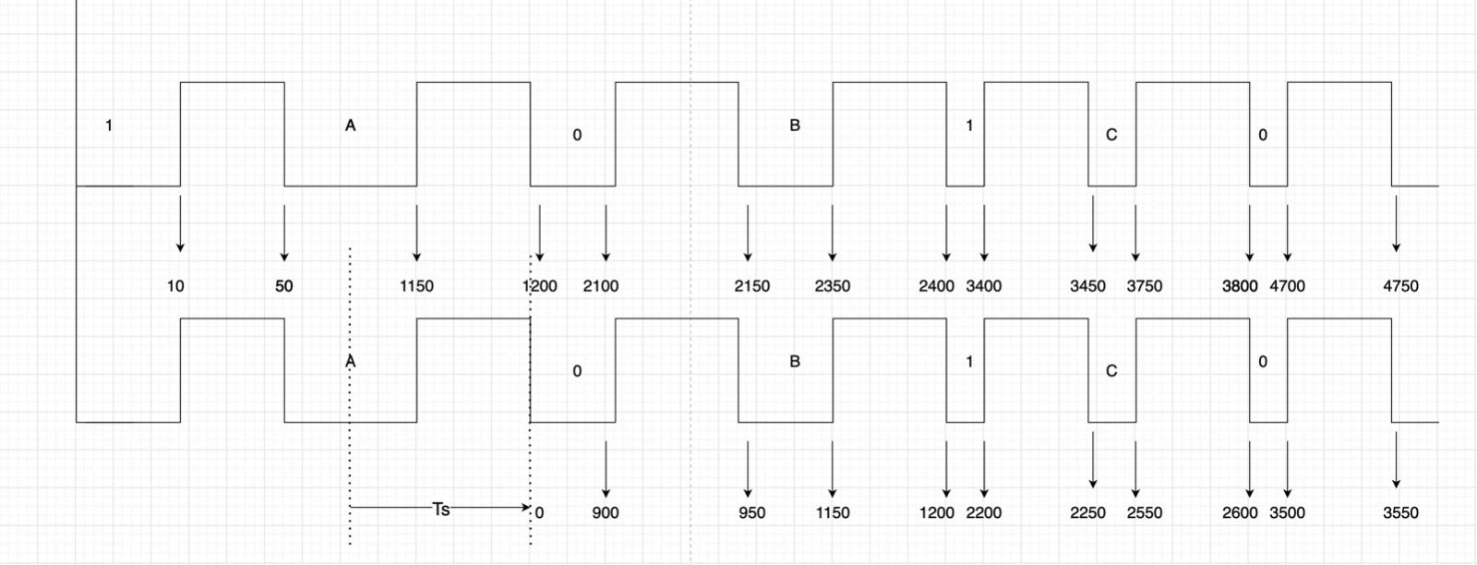
Synchronization

Slide 16
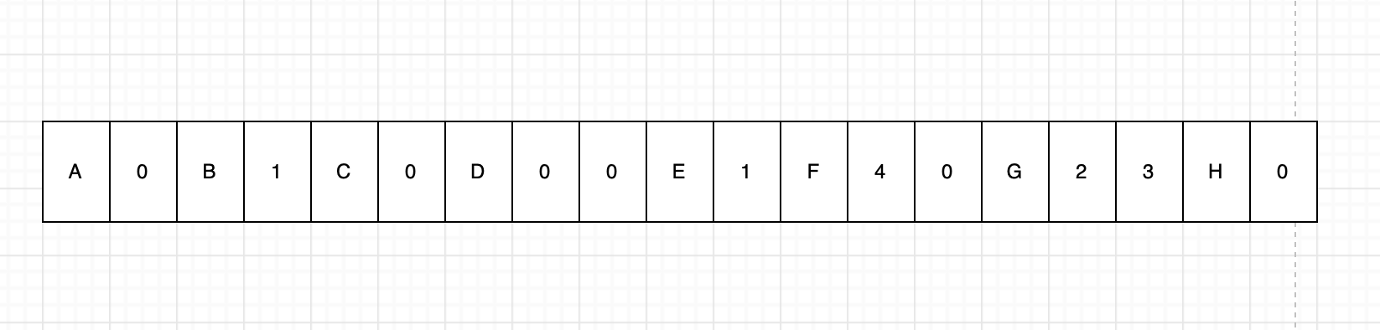
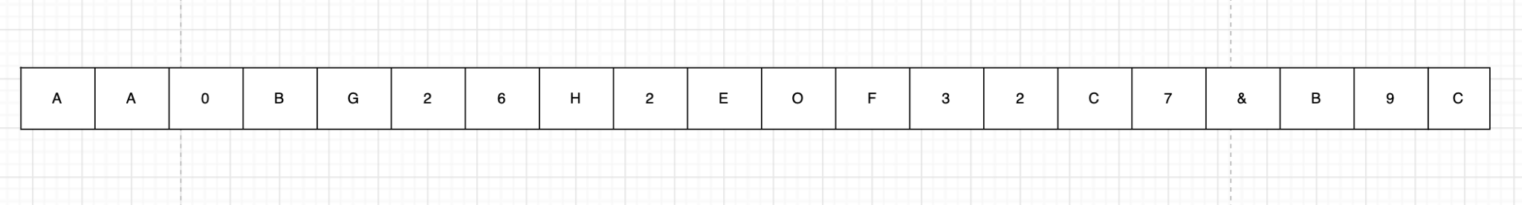
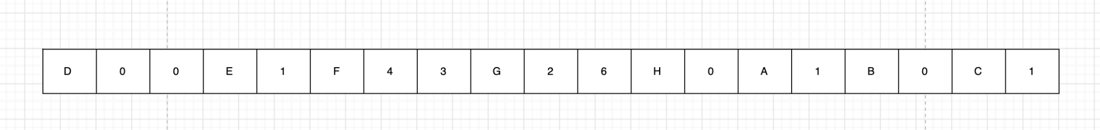
Data Transmission
Flame sensor | A0/A1
Alcohol Sensor | B0/B1
IR (Sleep) Sensor | C0/C1
Ultrasonic Sensor | D00/D99 (cm)
Vibration Sensor | E0/E1
Humidity Sensor | F00/F99
Temperature Sensor | G00/G99 (degree celsius)
Gas Sensor | H0/H1

Slide 17
Time for Data Transmission
The time taken for data transmission is given as total time taken for data transmission and for receiving data.
Td = Tt + Tr
Time taken for data transmission Tt = Time the total time taken by the transmitter to transmit each bit +delay between each bit(Td)*19
Time taken for receiving data Tr = Synchronization time(Ts) + Time the total time taken by the receiver to receive each bit +delay between each bit(Td)*19
Best case time = 13500 ms = 13.5s (A0B0C0D00E0F00G00H0)
Worst case time = 19400 ms = 19.4s (A1B1C1D99E1F99G99H1)

Slide 18
Test Cases
Case1: When two vehicles are travelling in same direction or opposite direction and if a vehicle ahead detects fire hazard within or in front of the vehicle.
Case2: When the person driving a vehicle is in drunk state.
Case3: When the person driving a vehicle is in sleeping.
Case4: When there is animal or car or accident in front of the vehicle.
Case5: When there is some mechanical issue inside a vehicle which is casing lot of vibration. Example: improper wheel balance.
Case6: When there is a rain or fog or high humidity on the road.
Case7: When there issue is some issue in a vehicle causing its engine temperature to rise.

Slide 19
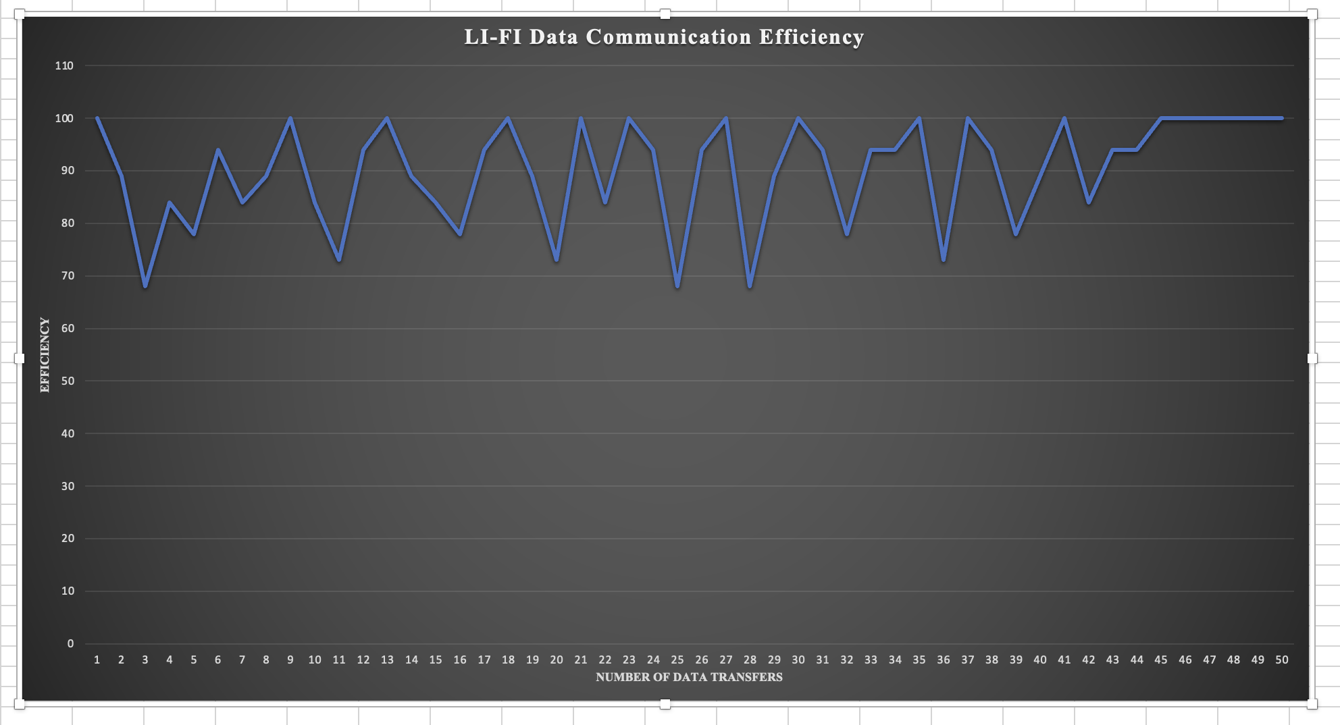
Performance Evaluation

Slide 20
Team Contribution
Team Member | Contribution
Chandrashekhar Akkenapally | 50%
Susheel Reddy Pingili | 50%

Slide 21


